Slide 1

INTERNITY FOUNDATION
FACE RECOGNITION ANALYTICS SYSTEM
Team: Technocrat
Team id: 3019
Team members:
VAIBHAV NOHRIA
GAURANSH SINGH
PRIYANKA PARASHAR

Slide 2
CONTEXT:
Problem Statement
Introduction
Face Detection
Face Extraction
Face Recognition
Limitations

Slide 3
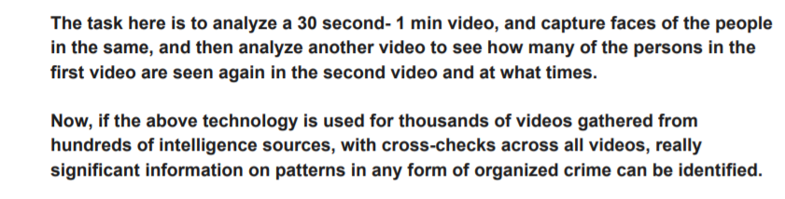
PROBLEM STATEMENT
Build a face recognition analytics system for law enforcement agencies.

Slide 4
Introduction
The presented model is a type of face recognition analytic system for law enforcement agencies.
It helps to enhance the security system of India where crime is rising in such an alarming rate.
Basically it is a video analyser, which records certain patterns from different videos.
The task of this model is to analyse a short video and capture the faces of people and compare those with the other videos to count that how many times the person is seen and also at what time.

Slide 5
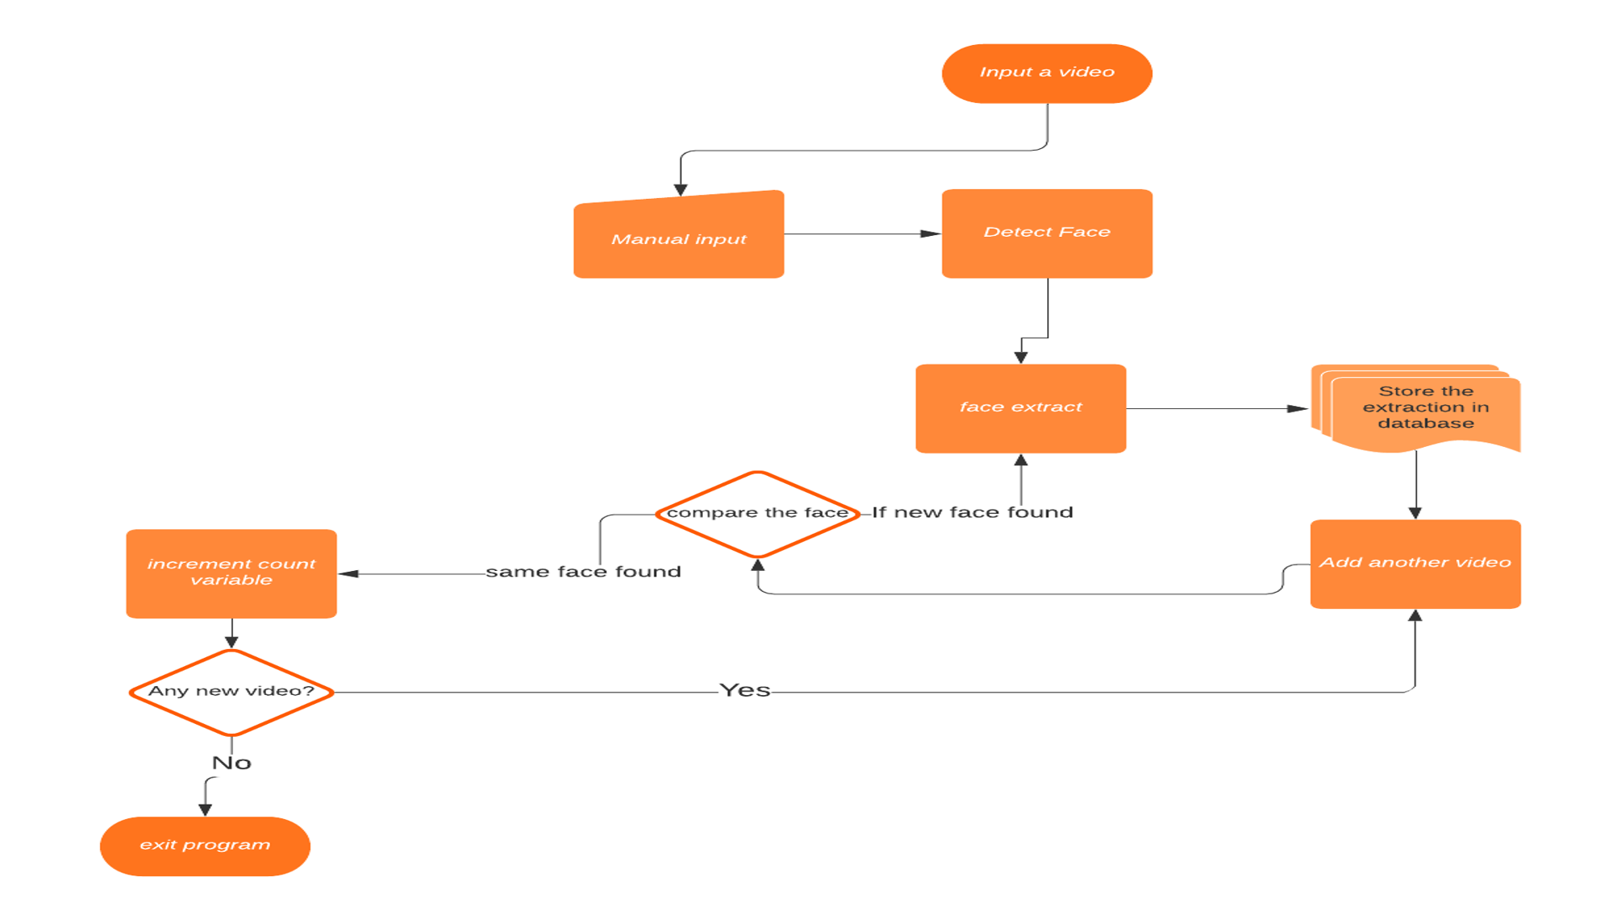
This model is based on following flow chart:
Display time stamp of the detected user id

Slide 6
Face Detection
The formulated model uses following libraries:
cv2
dlib
The process of face detection starts with importing of single or multiple videos by the user.
Various Machine Learning Algorithms such as Eigenvalue, Histogram and Support Vector Machine(SVM) help in Face Detection.
The next step is the detection of face co-ordinates.
Furthermore when all the faces are accurately detected, the model forms a rectangular block around each face.

Slide 7
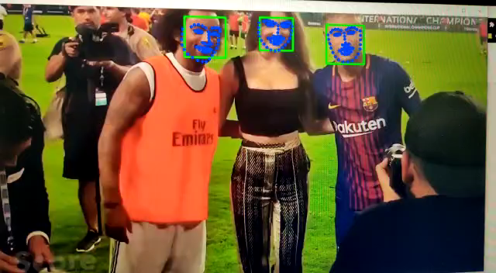

Slide 8
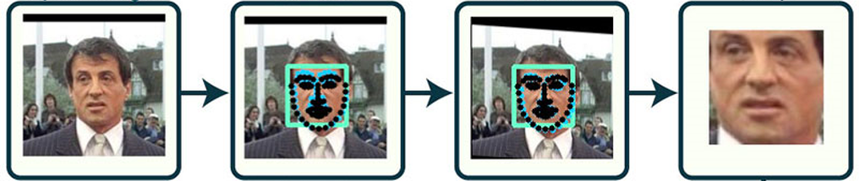
Face Extraction
The next stage of the model starts by extracting the faces inside the squared boxes. such as
The squared boxes are detected with the help of facial landmarking technique.
Facial landmarking technique include marking point over eyes, eyebrows, nose, jawline and lips.
All the faces are extracted individually and stored in the database.
The working of face extraction is shown below:

Slide 9
Database
All these faces are extracted and put up inside a folder.
This folder basically contains extracted faces detected at each frame.

Slide 10
FACE RECOGNITION
The extracted faces that are stored in the database, now act as a dataset.
We are using cnn deep learning model.
Whenever a face is detected from the video imported by the user, it is compared with the stored faces in the database so that we can observe number of times a person has been seen.
For every new face detected, the model creates a new face id along with it’s occurring time stamp. And the same process is followed.
All the face id’s detected along with time stamp are then sent to a empty csv file.
(Note: Highly recommended)
The csv file should not be opened at the time of facial recognition process is going on as it would result into an error. The type of csv file should be utf-8 which is suitable for our encoding technique.

Slide 11
Limitations
For facial recognition we are using CNN model. It is more efficient model than HOG and gives better results according to the suitable tolerance but lack behind in computation speed.
The formulated deep learning model depends completely on the type of processor and RAM.
The better the hardware, the faster the model.

Slide 12
THANK YOU

